Slide 1
Decentralized
Exchange
Final year project

Slide 2
Our Agenda
Introduction
Motivation and Goals
Features
Architecture
Working Mechanism
Implementation
Challenges
Technologies
Conclusion
Join us as we explore the revolutionary world DEX, uncovering their advantages over traditional centralized exchanges. Discover how DEX platforms enhance transparency while providing greater control over assets. Dive into the mechanics of liquidity pools, smart contracts, and automated market makers, and witness the transformative potential of DEX in shaping the future of finance.

Slide 3




Our Team
COMSATS University Islamabad, 2022-23
Mujtaba Rehman
Bilal Ahmad
Abdullah Bin Zubair
Blockchain dev
Full stack web dev
Web3 dev
Sir. Akhzar Nazir
Supervisor

Slide 4
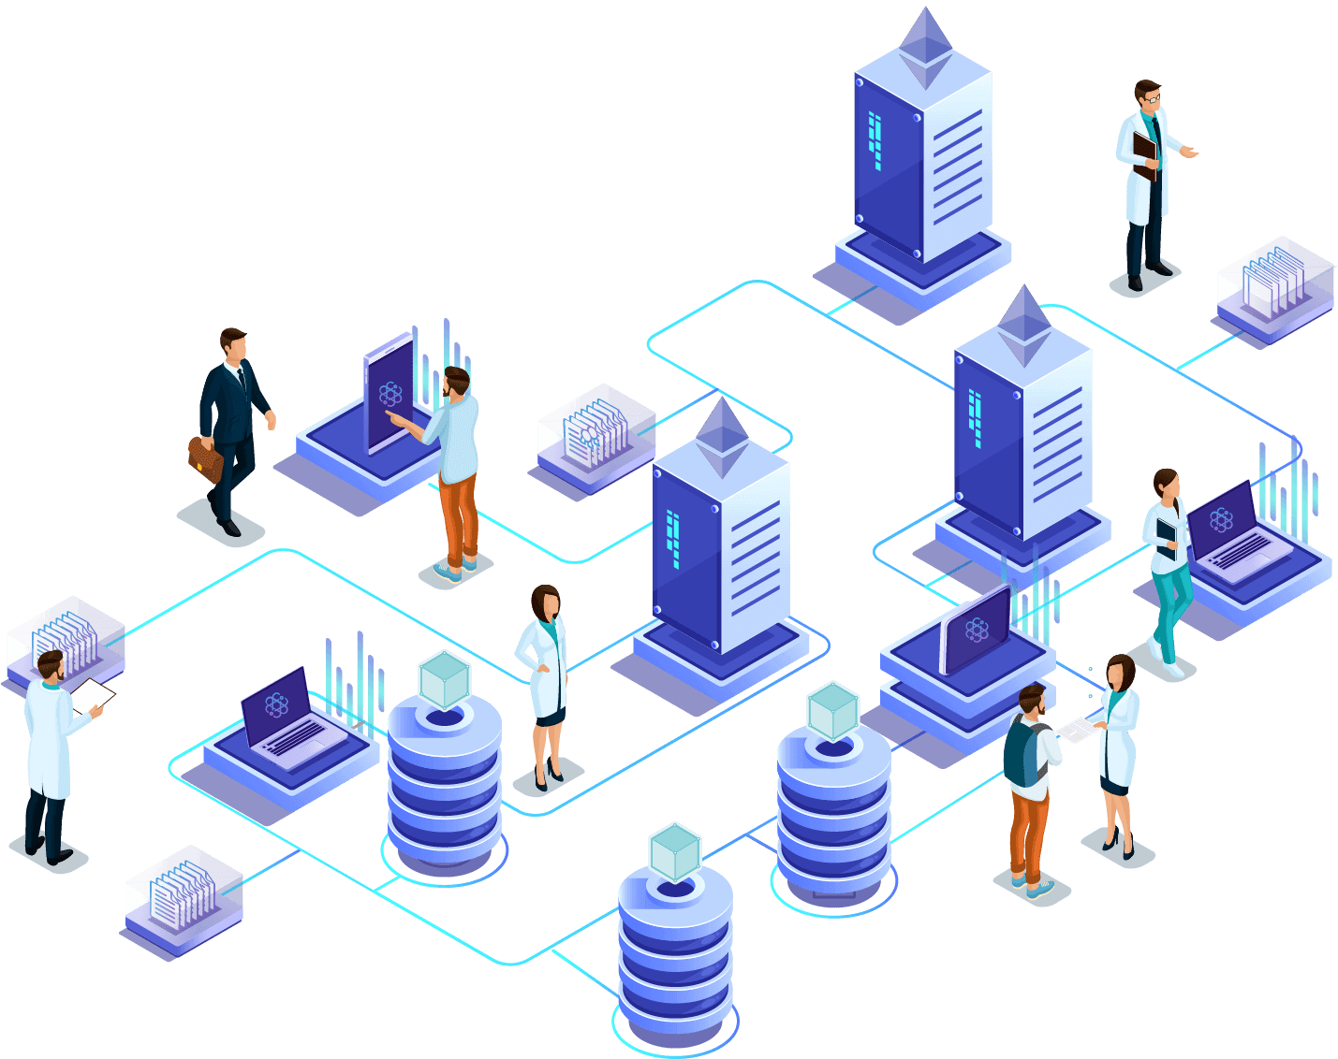
Decentralized
Exchange
Dex, short for decentralized exchange, is a type of cryptocurrency exchange that operates on a decentralized network, typically utilizing blockchain technology. Unlike centralized exchanges that rely on intermediaries to facilitate trades and store user funds, DEXs allow users to trade cryptocurrencies directly with one another without the need for a trusted third party.

Slide 5



Goals & Objective
Objective
Creating a secure and efficient platform for decentralized cryptocurrency trading.
Problem Statement
To propel the adoption and growth of DEXs, it is crucial to establish clear goals and objectives that encompass various aspects. These goals may include enhancing user experience by providing seamless and intuitive interfaces, fostering liquidity to ensure efficient trading, promoting interoperability among different DEX protocols, and implementing robust security measures to safeguard users' funds.
Addressing trust, security, and control concerns associated with centralized exchanges.
Solution
Implementing a decentralized exchange leveraging blockchain technology.

Slide 6





Why Decentralized Exchange ?
Here are some key features and properties of decentralized exchanges
Decentralization
Transparency
Peer to peer trading
Privacy
Security

Slide 7






DEX Features
Decentralized exchanges offer several features that differentiate them from centralized exchanges
Token
Listing
Token Creation
Swapping
Pool
Creation
Top
Pools
Bridge

Slide 8




DEX Architecture
Wallet Integration
Integrating secure wallets for robust fund storage and management
User Interface
Designing an intuitive and user-friendly interface for seamless interaction with the DEX.
Smart Contract
Developing smart contracts to facilitate trading, automate order matching, and settlement.
Blockchain
Utilizing a suitable blockchain platform for the decentralized exchange.

Slide 9
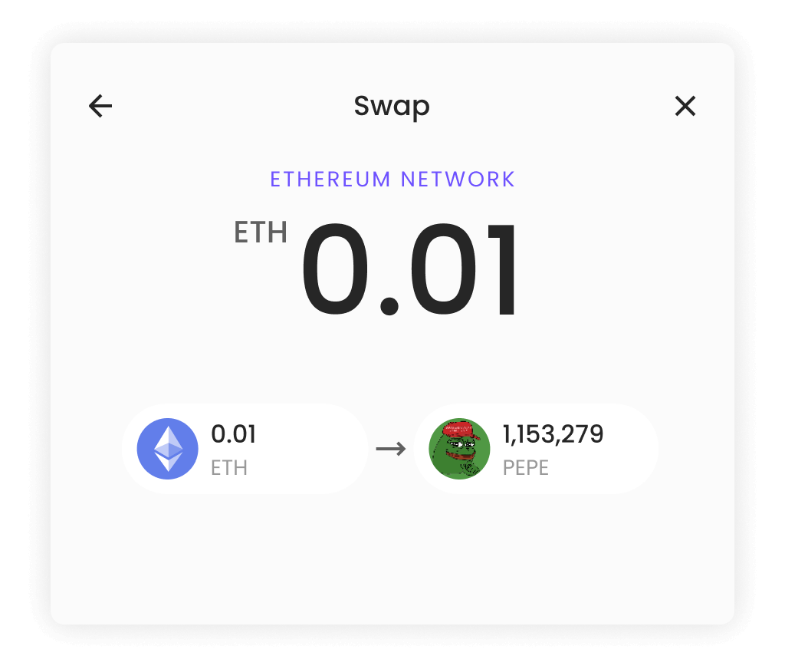
DEX Swapping
DEX swapping refers to the process of exchanging one cryptocurrency for another directly on a decentralized exchange (DEX) platform. Unlike traditional centralized exchanges, DEXs operate on a blockchain network and allow users to trade cryptocurrencies directly with each other without the need for intermediaries.

Slide 10
DEX Smart Contract
Backbone of Blockchain
Deploy
Smart contracts are deployed on blockchains like Ethereum etc.
Code-Driven Execution
It executes when the terms of agreement written in the code are fulfilled.
Immutable
These are immutable and cannot be modified.
Automation
Smart contracts executed automatically without the need of any intermediary
Trustless
They eliminate the need for trust between parties.

Slide 11
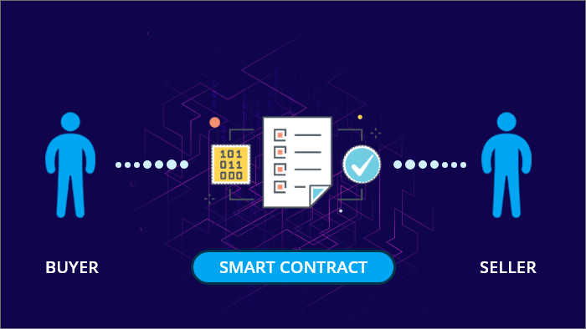

Slide 12
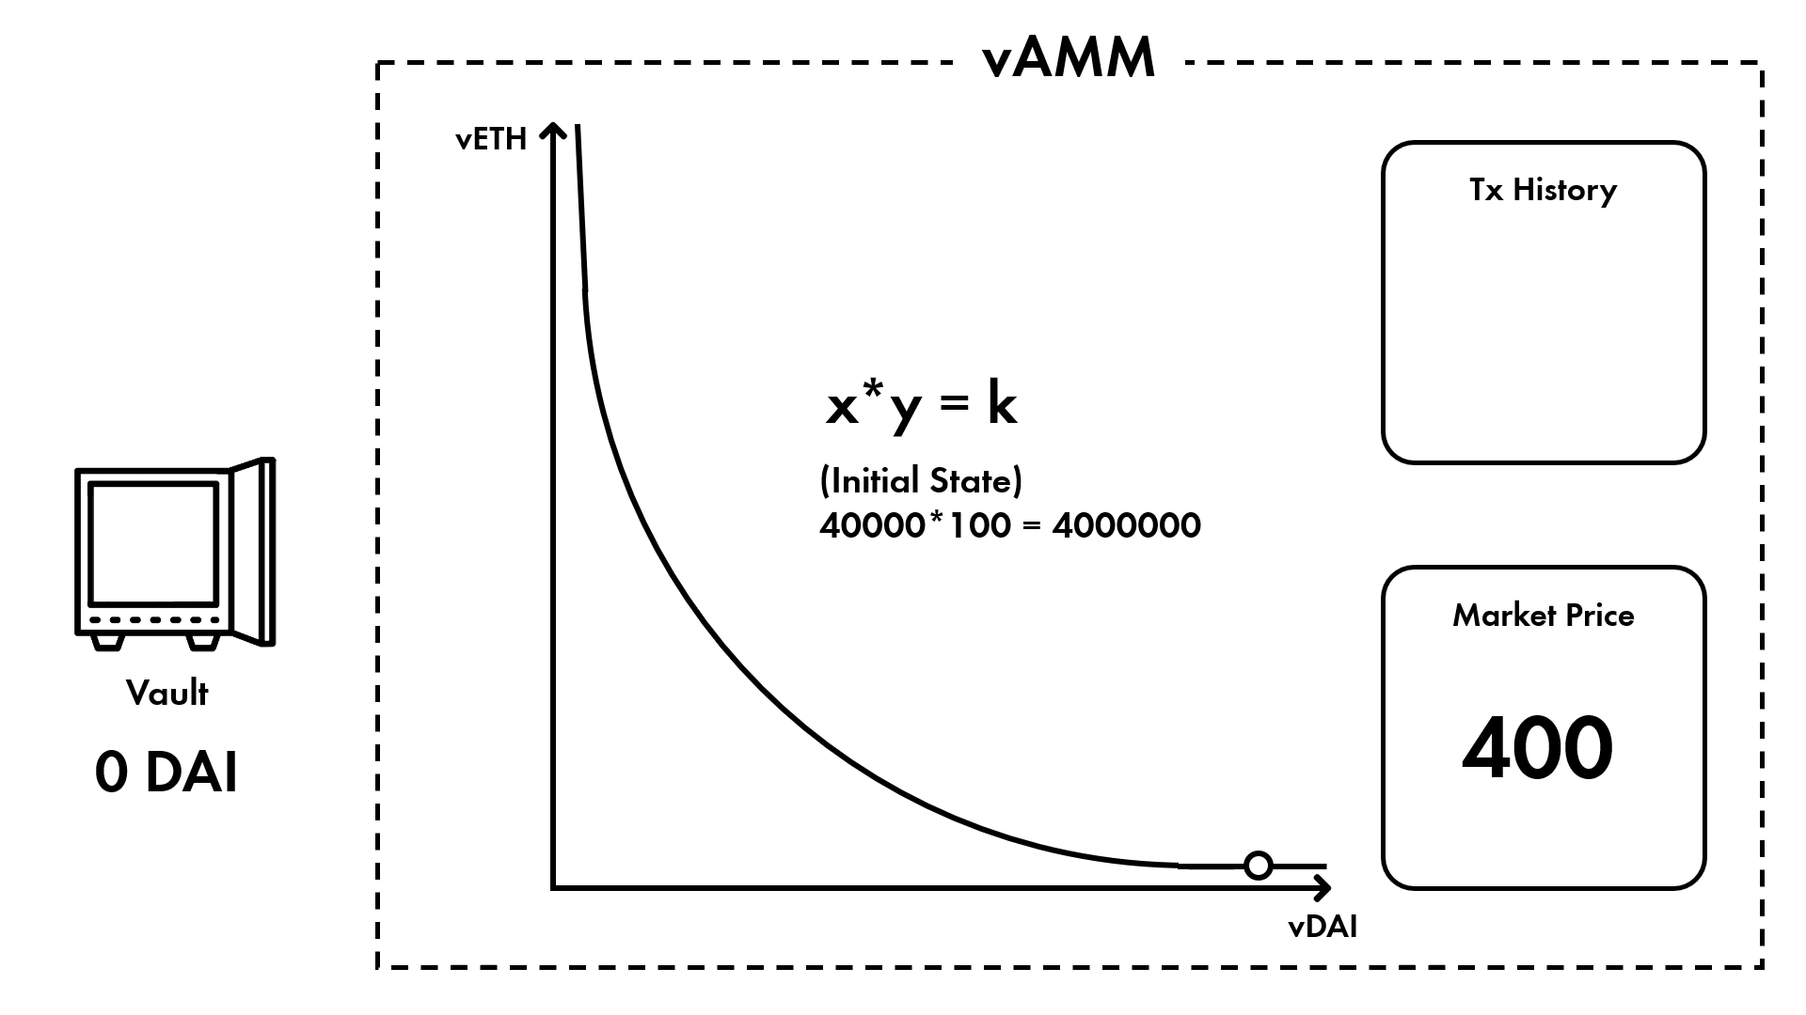
Unlocking Liquidity: The Revolution of DEX AMMs
01
Automated trading
AMM enables automated and decentralized trading using algorithms to price assets in liquidity pools.
02
No intermediaries
AMMs enable the swapping of digital assets without relying on traditional order books or intermediaries.
03
Direct user interaction
Users interact directly with AMM which executes their trades based on current pool ratio.
04
Pricing algorithm
AMMs use a pricing algorithm, typically based on the constant product formula to calculate the asset exchange rates within the pool.
x * y = k

Slide 13
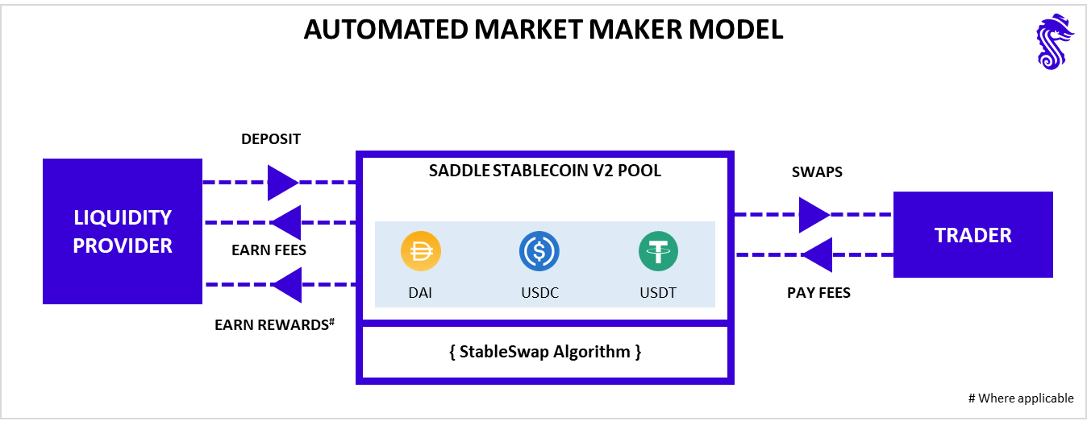

Slide 14
Liquidity Pool
Liquidity pools are reserves of funds formed by liquidity providers who deposit their funds into the pool.
LQ
Liquidity Pools
Direct Trading
Liquidity pools enable the trading of assets without matching buyers and sellers directly.
DT
ER
Earning Rewards
Liquidity providers earn fees or rewards for providing liquidity to the pool.
Pairing Assets
In a liquidity pool, assets are paired together (e.g., ETH/USDT) to create trading pairs.
PA
PD
Price Dynamics
The pool's pricing is determined by an automated market maker (AMM) algorithm.

Slide 15
Concentrated liquidity
Price Ranges
Concentrated liquidity focuses on specific price ranges in decentralized exchanges.
Flexible Allocation
Liquidity providers can adjust their allocation based on market conditions and strategies.
Targeted Allocation
Liquidity providers allocate funds to these ranges instead of providing liquidity across the entire spectrum.
Dynamic Adjustments
Ranges can be dynamically adjusted to adapt to changing market conditions.
Potential Returns
It aims to increase capital efficiency and potentially earn higher returns.
Optimization
It optimizes capital usage and provides deeper liquidity for targeted price ranges.

Slide 16
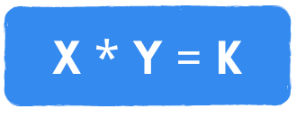
Price Calculation
The constant product formula is used to calculate the price of the assets in a liquidity pool.
The formula assumes that the product of the quantities of two assets in a liquidity pool remains constant.
This means that as one asset is bought, its price increases, while the price of the other asset decreases. Hence, the product of their quantities remains constant.
When a trade occurs, the formula is used to determine the new quantities of assets in the pool.
However, slippage and fees can affect the execution price and may result in a slightly different outcome.

Slide 17
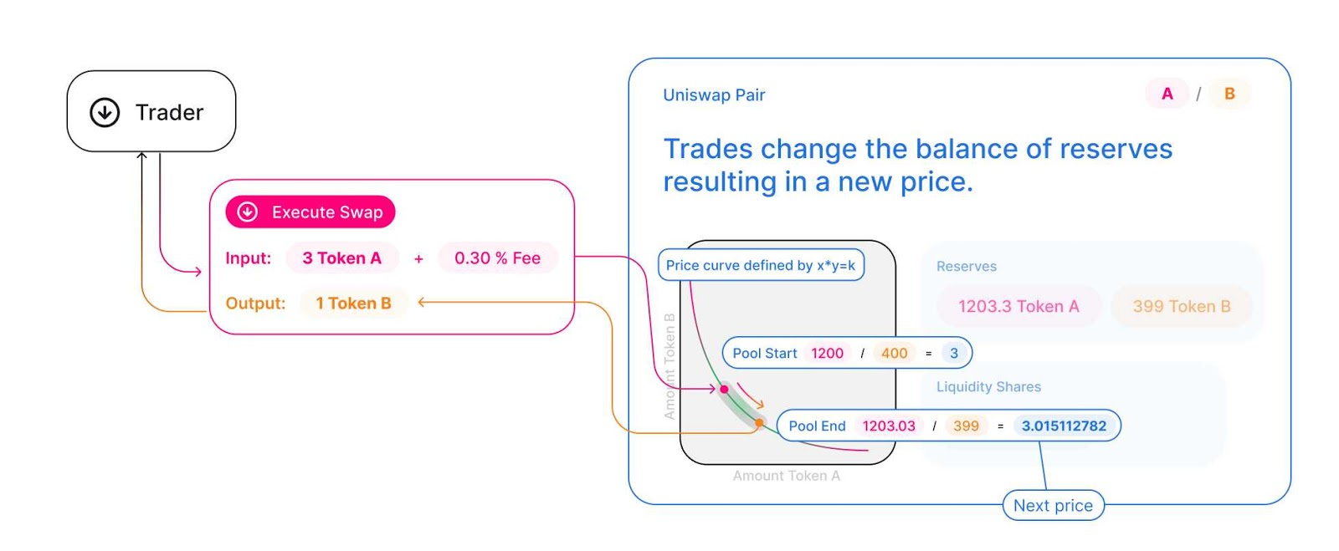

Slide 18

Network of Blockchain
Transparent
It acts as a connection between two or more blockchain networks that may have different protocols.
It ensures that assets locked or deposited on one blockchain can be securely and transparently transferred to another blockchain.
Bridge Architecture
Verification
Seamless Assets Flow
The bridge consists of smart contracts that facilitate the transfer and verification of assets across blockchains.
It helps overcome the limitations of individual blockchains by creating a unified ecosystem where assets can flow seamlessly across multiple networks.

Slide 19
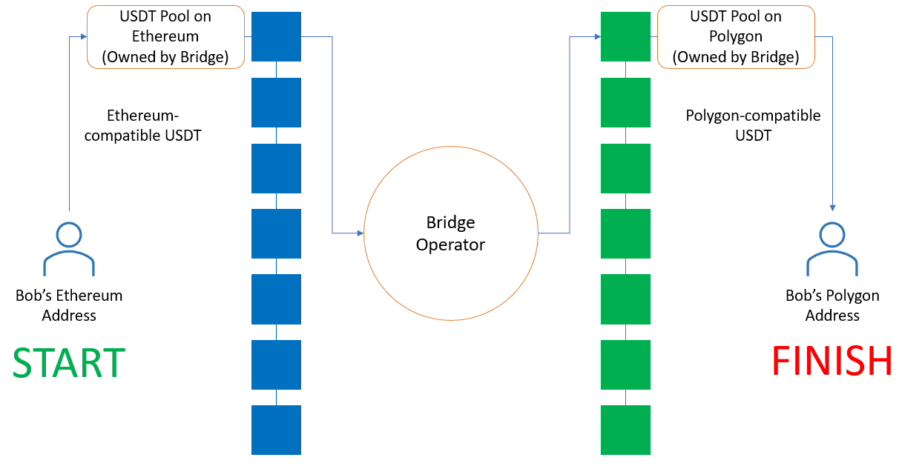

Slide 20
Implementation Procedure
Thoroughly researching DEX
Study existing protocols
Understand working technologies
RND

Slide 21
Blockchain Selection
BS
Identifying and selecting the most appropriate blockchain platform for the project.
Smart Contract
Development
SCD
Creating smart contracts for efficient order book management, order matching, and settlement.
User Interface Design
UX
Crafting an intuitive and visually appealing interface for traders to engage with the DEX.

Slide 22
Wallet Integration
WI
Identifying and selecting the most appropriate blockchain platform for the project.
Testing &
Debugging
TND
Rigorously testing and debugging the platform to ensure functionality and stability.
Deployment
DM
Deploying the decentralized exchange on the selected blockchain network.

Slide 23
Security Audits
Integrating reputable wallet services for secure and convenient fund management.
SA
Finish

Slide 24
Key Challenges
Liquidity
Attracting and incentivizing users and market makers to ensure healthy liquidity on the exchange.
User Experience
Prioritizing a seamless and intuitive user experience to drive adoption and user satisfaction.
02
04
Interoperability between different blockchain networks and addressing liquidity concerns are significant challenges that developers must tackle.
SC
LI
RC
UX
01
03
Scalability
Mitigating scalability challenges inherent in blockchain technology to accommodate high transaction volumes.
Regulatory Compliance
Adhering to regulatory requirements and complying with relevant laws and regulations.

Slide 25







Tools Technologies
Various tools and technologies utilized in our project or organization. We leverage a range of cutting-edge tools and technologies to streamline processes, enhance efficiency, and drive innovation. Our tech stack includes industry-leading software and hardware solutions that empower us to deliver high-quality results and stay at the forefront of our field.

Slide 26
Final Conclusion
Recap
Summarizing the achievements and contributions of DEX project.
Potential Impact
Highlighting the transformative of DEX in revolutionizing crypto trading.
In conclusion, decentralized exchanges (DEXs) hold tremendous potential in revolutionizing the way we trade and interact with cryptocurrencies. By eliminating intermediaries and relying on blockchain technology, DEXs offer enhanced security, transparency, and control over users' assets.
Acknowledgments
Expressing gratitude to advisors, mentors, and contributors for their support.

Slide 27
THANKS
for listening us carefully and we hope that we were able to provide you with the information you were seeking. If you have any further questions or need assistance with anything else, please feel free to ask. We're here to help!

Slide 28
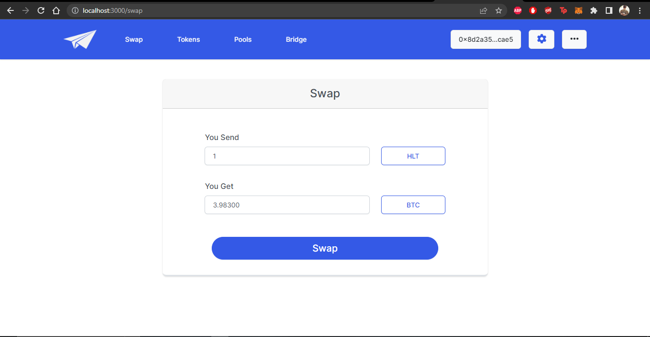
Laptop Device View
SWAP Page

Slide 29
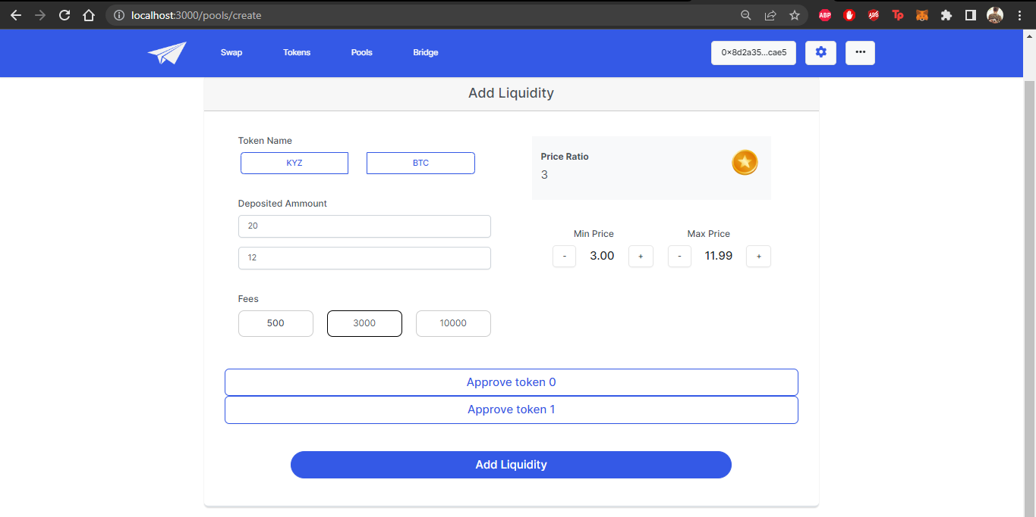
Laptop Device View
Add Liquidity

Slide 30
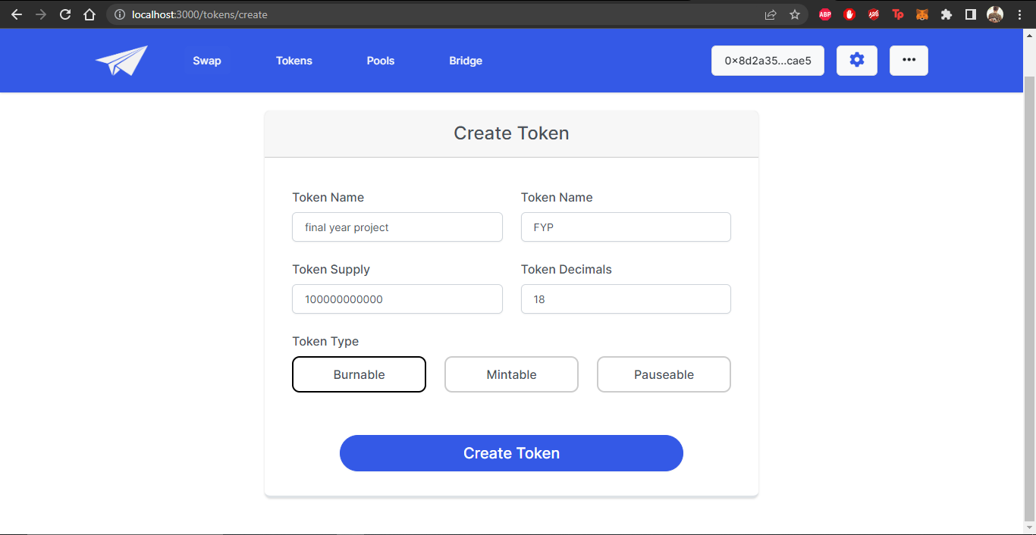
Laptop Device View
Create Token Page

Slide 31
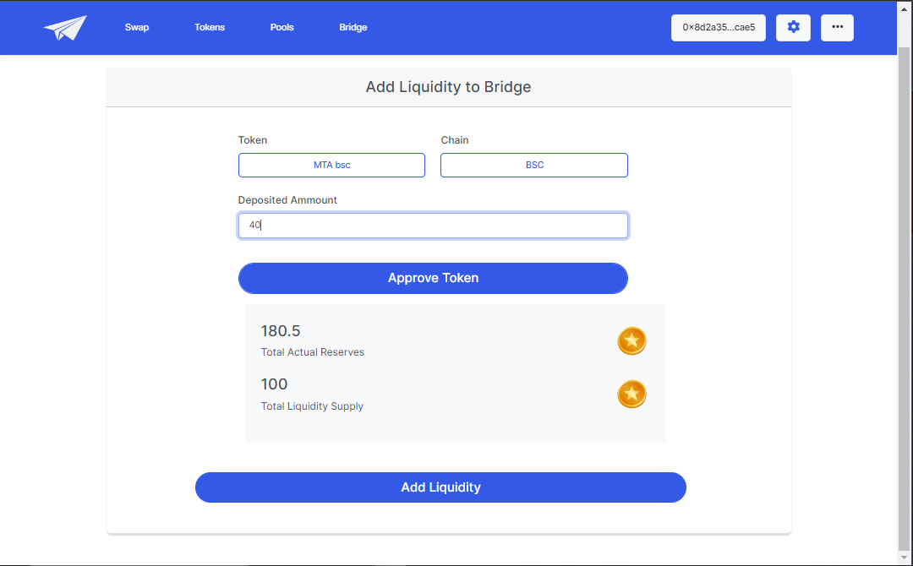
Laptop Device View
Add Liquidity To Bridge

Slide 32
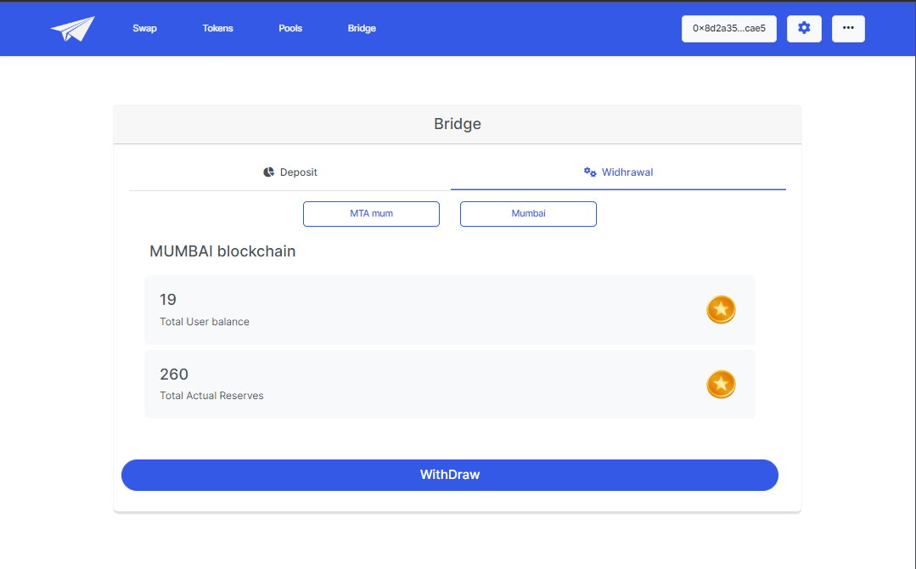
Monitor Device View
Withdraw Liquidity From Bridge

Slide 33
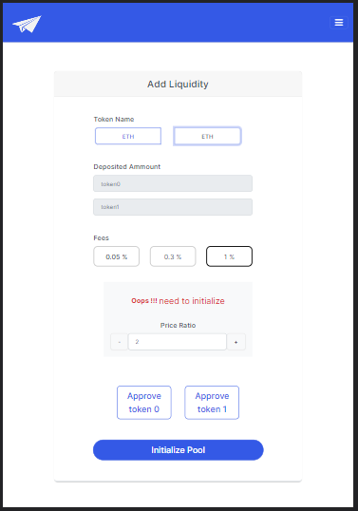
Tablet Device View
Initialize Pool

Slide 34
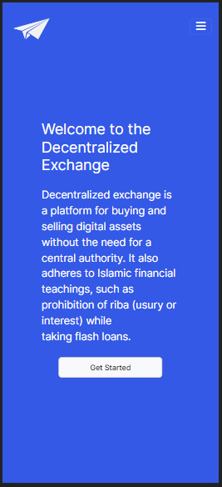
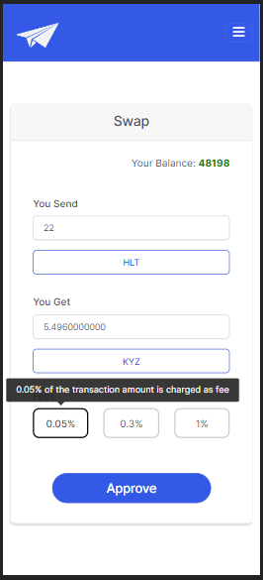
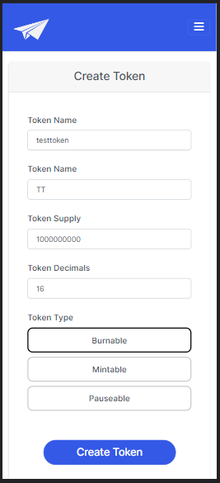
Mobile Interface View
Screen #1
Screen #2
Screen #3

Slide 35
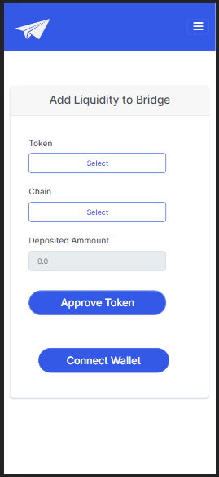
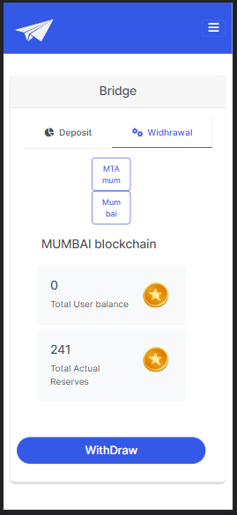
Mobile Interface View
Screen #4
Screen #5

